Slide 1
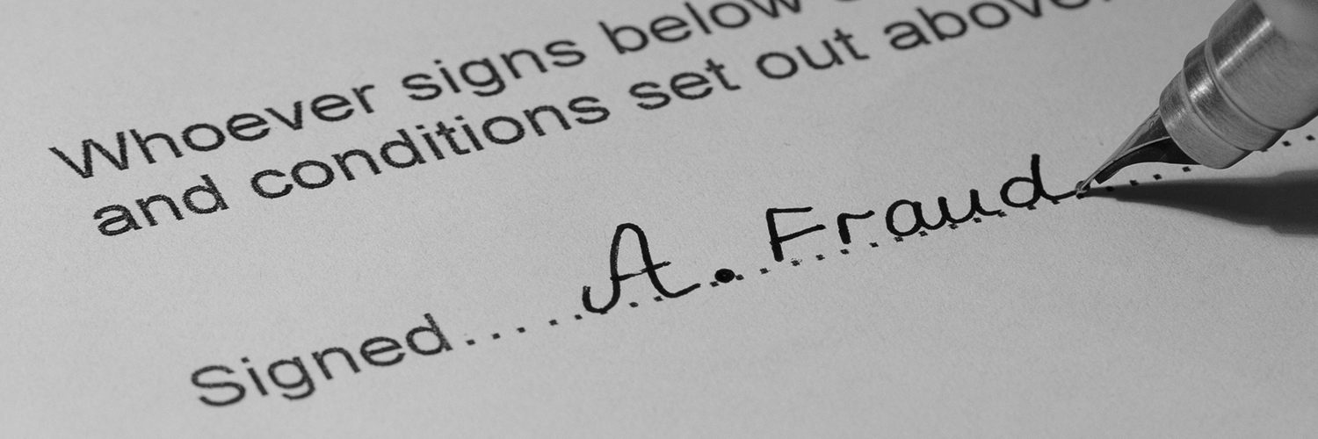

Slide 2
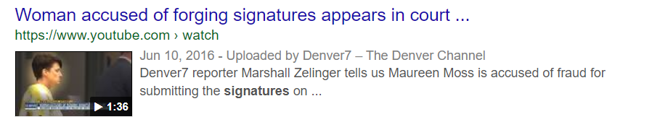
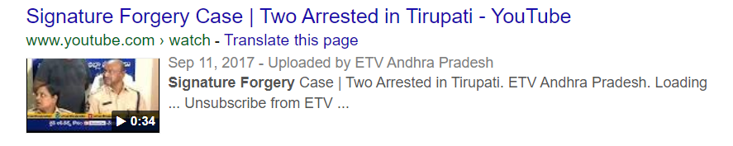
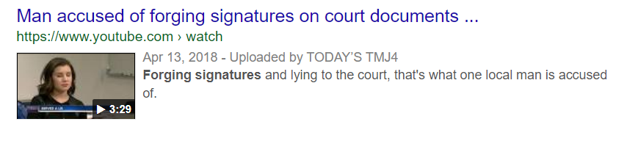
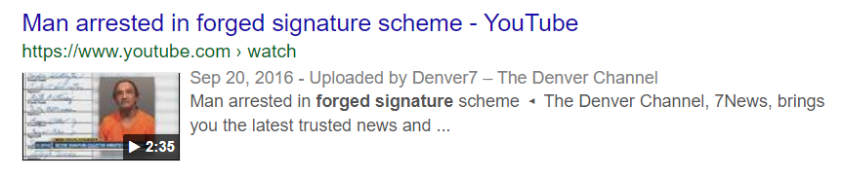

Slide 3
FORGERY DETECTION
GORTHI JASWANTH
MAGANURU JAYASURYA
PAGIDIPALLY ADVAITH ALENKRITH
VEMULAPALLI PRAKHYATH SREE HARSHA

Slide 4
OVERVIEW
Data Pre-processing
Database
Designing of Neural Network
Training and Testing
Performance Evaluation

Slide 5
Data Pre-processing
Signatures are scanned in gray
The preprocessing stage includes four steps:
Noise reduction
Width normalization
Thinning

Slide 6
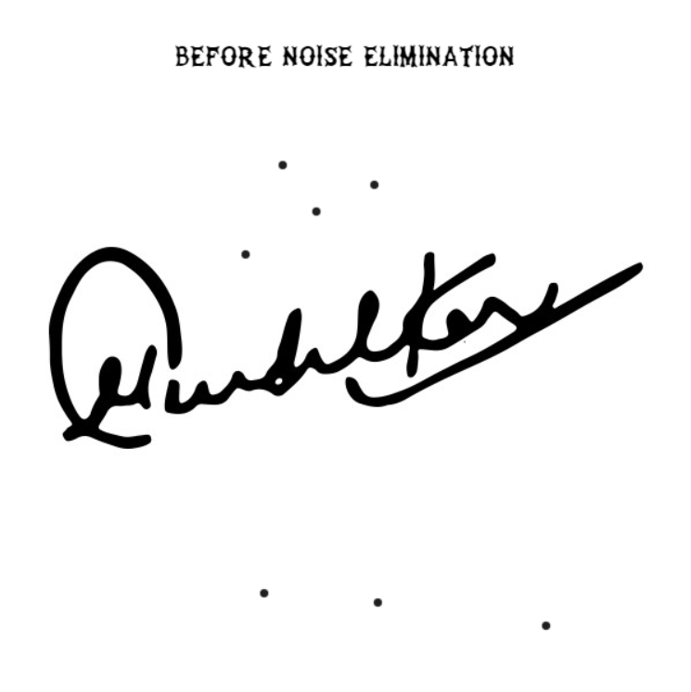
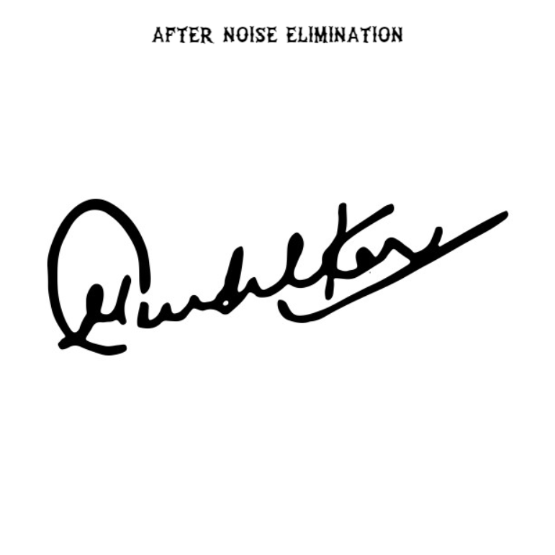

Slide 7

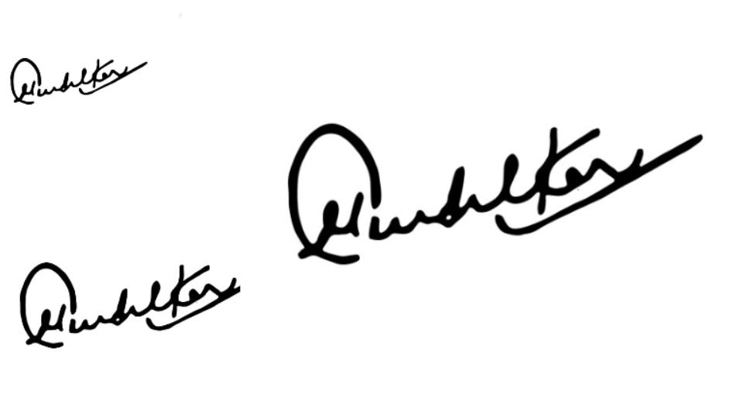
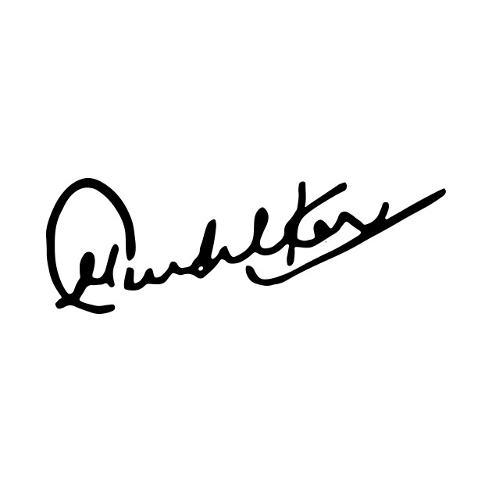
DIFFERENT SIZES BEFORE WIDTH NORMALIZATION
SIZE AFTER WIDTH NORMALIZATION

Slide 8
THINNING

Slide 9


5 X 5
25

Slide 10
Training and Testing
A training stage consist of three major steps :
Retrieval of a signature image from a database
Preprocess the signature by the steps discussed earlier
Back propagation neural network training
A Testing stage consists of four major steps :
Retrieval of a signature to be tested from a database
Pre-process the signature by the steps discussed earlier
Application of extracted features to a trained neural network
Checking output generated from a neural network declaring signature as genuine or forged

Slide 11
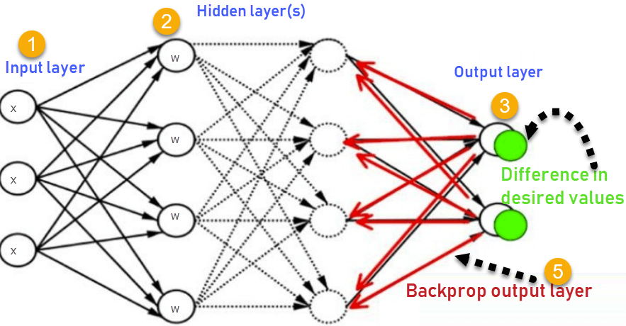

Slide 12
Performance Evaluation
Accuracy is the parameter used for measuring performance of any signature verification method
Accuracy = Numbers of forgeries accepted + originals accepted/ Total number of signatures tested X 100
References
https://ipythonquant.wordpress.com/2018/08/26/signature-verification-with-deep-learning-transfer-learning-using-keras-and-knime/
https://ieeexplore.ieee.org/document/4054529

